Slide 1
Cost Curves

Slide 2
Short-Run versus Long-Run Decisions
short run The period of time for which two conditions hold: The firm is operating under a fixed scale (fixed factor) of production, and firms can neither enter nor exit an industry.
long run That period of time for which there are no fixed factors of production: Firms can increase or decrease the scale of operation, and new firms can enter and existing firms can exit the industry.

Slide 3
Costs in the Short Run
fixed cost Any cost that does not depend on the firms’ level of output. These costs are incurred even if the firm is producing nothing. There are no fixed costs in the long run.
variable cost A cost that depends on the level of production chosen.
total cost (TC) Total fixed costs plus total variable costs.
TC = TFC + TVC

Slide 4
Fixed Costs
Total Fixed Cost (TFC)
total fixed costs (TFC) or overhead The total of all costs that do not change with output even if output is zero.
TABLE 8.1 Short-Run Fixed Cost (Total and Average) of a Hypothetical Firm
(1) q | (2) TFC | (3) AFC (TFC/q)
0 1 2 3 4 5 | $100 100 100 100 100 100 | $ − 100 50 33 25 20

Slide 5

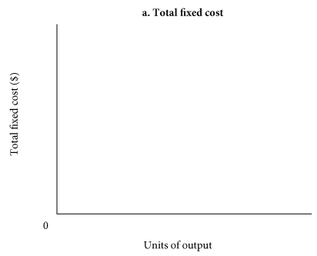
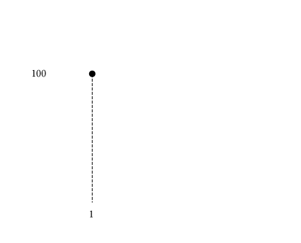
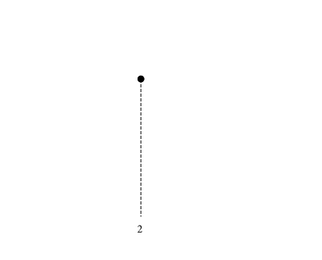
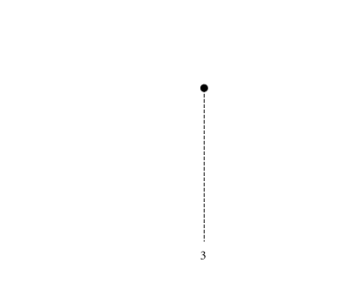
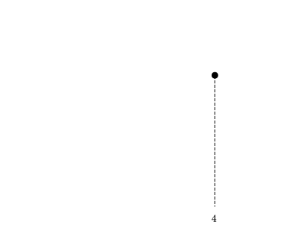
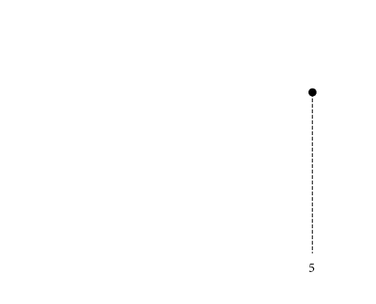
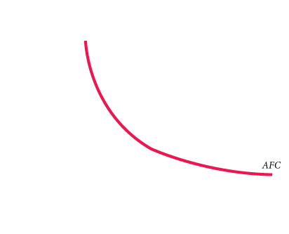
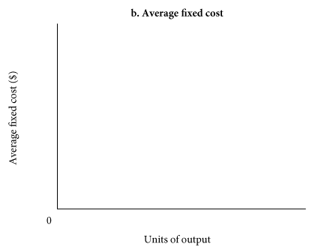
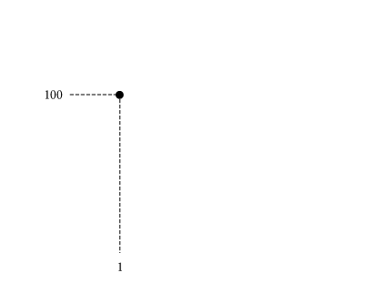
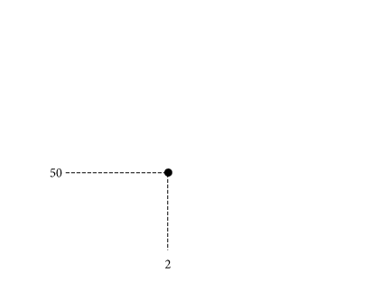
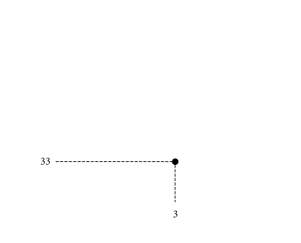
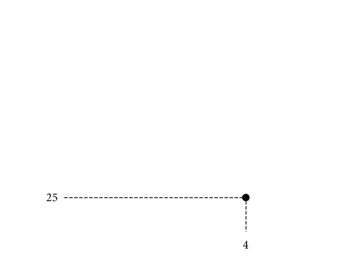
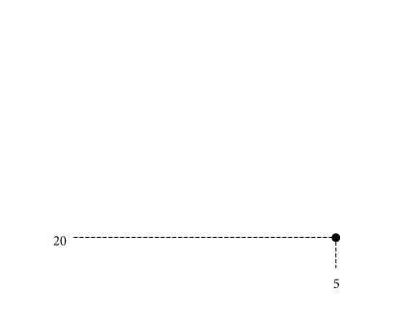
Average Fixed Cost (AFC)
average fixed cost (AFC) Total fixed cost divided by the number of units of output; a per-unit measure of fixed costs.
① FIGURE 8.2 Short-Run Fixed Cost (Total and Average) of a Hypothetical Firm
Average fixed cost is simply total fixed cost divided by the quantity of output.
As output increases, average fixed cost declines because we are dividing a fixed number ($1,000) by a larger and larger quantity.
spreading overhead The process of dividing total fixed costs by more units of output. Average fixed cost declines as quantity rises.

Slide 6
Variable Costs
Total Variable Cost (TVC)
total variable cost (TVC) The total of all costs that vary with output in the short run.
TABLE 8.2 Derivation of Total Variable Cost Schedule from Technology and Factor Prices
Produce
Using Technique
Units of Input Required (Production Function) K L
Total Variable Cost Assuming P_{K} = $2, P_{L} = $1 TVC = (K x P_{K}) + (L x P_{L})
1 unit of output
A
B
10
6
7
8
(10 x $2) + (7 x $1) = $27
(6 x $2) + (8 x $1) = $20
2 units of output
A B
16
11
8
16
(16 x $2) + (8 x $1) = $40
(11 x $2) + (16 x $1) = $38
3 units of output
A B
19
18
15 22
(19 x $2) + (15 x $1) = $38
(18 x $2) + (22 x $1) = $58

Slide 7
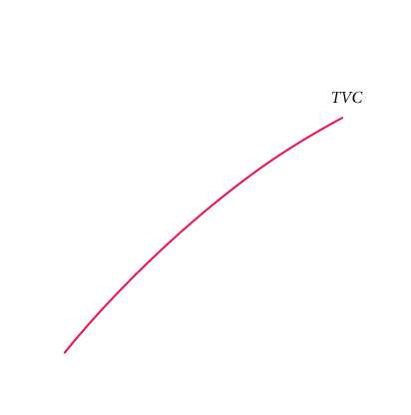
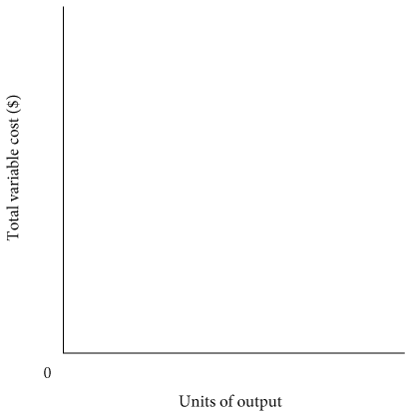
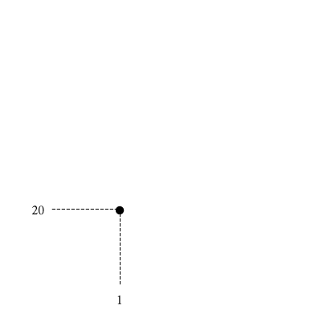
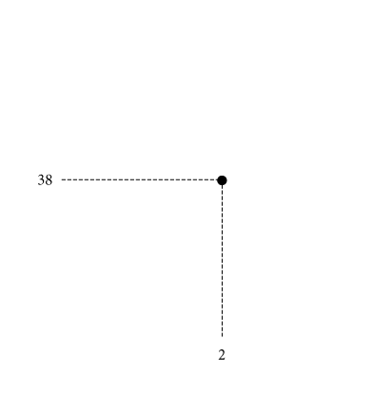
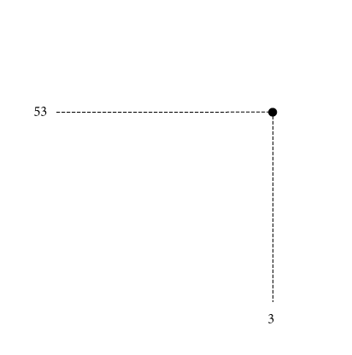
total variable cost curve A graph that shows the relationship between total variable cost and the level of a firm’s output.
④ FIGURE 8.3 Total Variable Cost Curve
In Table 8.2, total variable cost is derived from production requirements and input prices.
A total variable cost curve expresses the relationship between TVC and total output.

Slide 8
Marginal Cost (MC)
marginal cost (MC) The increase in total cost that results from producing 1 more unit of output. Marginal costs reflect changes in variable costs.
TABLE 8.3 Derivation of Marginal Cost from Total Variable Cost
Units of Output | Total Variable Costs ($) | Marginal Costs ($)
0 1 2 3 | 0 20 38 53 | 20 18 15

Slide 9
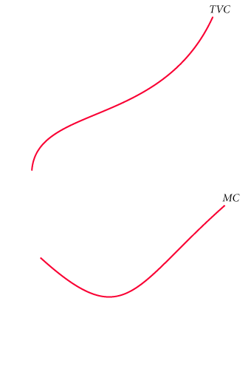
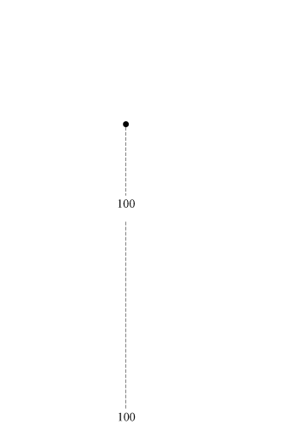
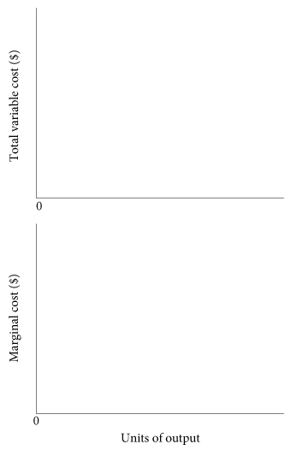
Graphing Total Variable Costs and Marginal Costs
④ FIGURE 8.5 Total Variable Cost and Marginal Cost for a Typical Firm
Total variable costs always increase with output.
Marginal cost is the cost of producing each additional unit.
Thus, the marginal cost curve shows how total variable cost changes with single-unit increases in total output.

Slide 10
Average Variable Cost (AVC)
average variable cost (AVC) Total variable cost divided by the number of units of output.
TABLE 8.4 Short-Run Costs of a Hypothetical Firm
(1) q | (2) TVC |  |  | (3) MC (Δ TVC) |  |  | (4) AVC (TVC/q) |  |  | (5) TFC |  |  | (6) TC (TVC + TFC) |  |  | (7) AFC (TFC/q) |  |  | (8) ATC (TC/q or AFC + AVC)
0 | $ | 0.00 |  | $ | - |  | $ | - |  | $ | 100.00 |  | $ | 100.00 |  | $ | - |  | $ | -
1 |  | 20.00 |  |  | 20.00 |  |  | 20.00 |  |  | 100.00 |  |  | 120.00 |  |  | 100.00 |  |  | 120.00
2 |  | 38.00 |  |  | 18.00 |  |  | 19.00 |  |  | 100.00 |  |  | 138.00 |  |  | 50.00 |  |  | 69.00
3 |  | 53.00 |  |  | 15.00 |  |  | 17.66 |  |  | 100.00 |  |  | 153.00 |  |  | 33.33 |  |  | 51.00
4 |  | 65.00 |  |  | 12.00 |  |  | 16.25 |  |  | 100.00 |  |  | 165.00 |  |  | 25.00 |  |  | 41.25
5 |  | 75.00 |  |  | 10.00 |  |  | 15.00 |  |  | 100.00 |  |  | 175.00 |  |  | 20.00 |  |  | 35.00
6 |  | 83.00 |  |  | 8.00 |  |  | 13.83 |  |  | 100.00 |  |  | 183.50 |  |  | 16.67 |  |  | 30.50
7 |  | 94.50 |  |  | 11.50 |  |  | 13.50 |  |  | 100.00 |  |  | 194.50 |  |  | 14.28 |  |  | 27.78
8 |  | 108.00 |  |  | 13.50 |  |  | 13.50 |  |  | 100.00 |  |  | 208.00 |  |  | 12.50 |  |  | 26.00
9 |  | 128.50 |  |  | 20.50 |  |  | 14.28 |  |  | 100.00 |  |  | 228.50 |  |  | 11.11 |  |  | 25.39
10 |  | 168.50 |  |  | 40.00 |  |  | 16.85 |  |  | 100.00 |  |  | 268.50 |  |  | 10.00 |  |  | 26.85

Slide 11
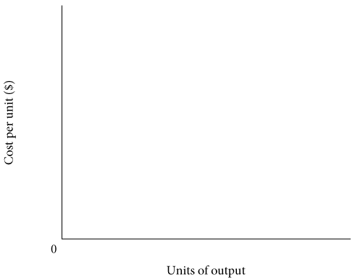
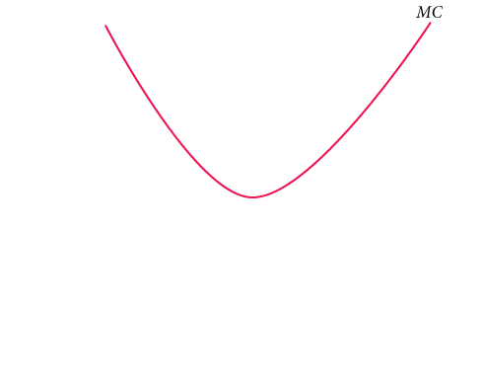
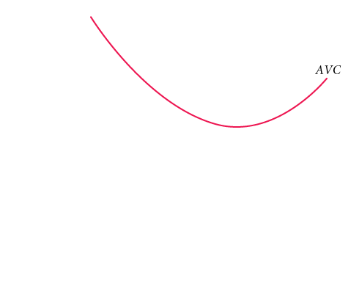
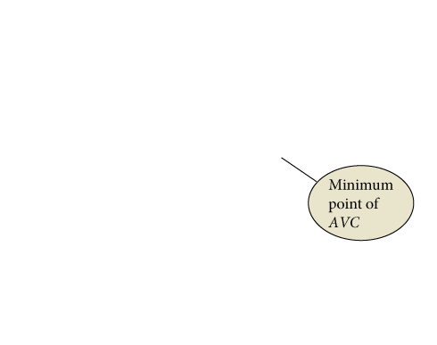
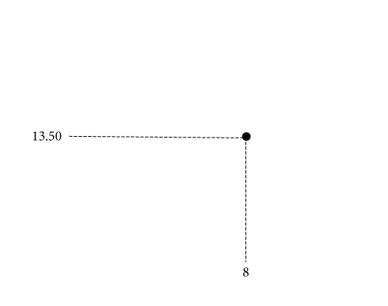
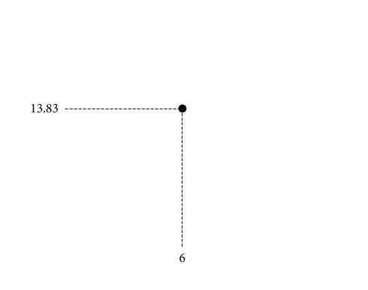
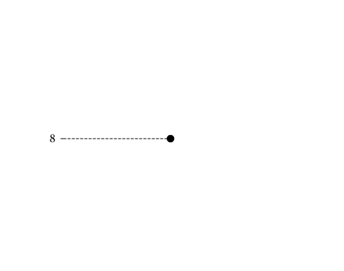
Graphing Average Variable Costs and Marginal Costs
④ FIGURE 8.6 More Short-Run Costs
When marginal cost is below average cost, average cost is declining.
When marginal cost is above average cost, average cost is increasing.
Rising marginal cost intersects average variable cost at the minimum point of AVC.

Slide 12
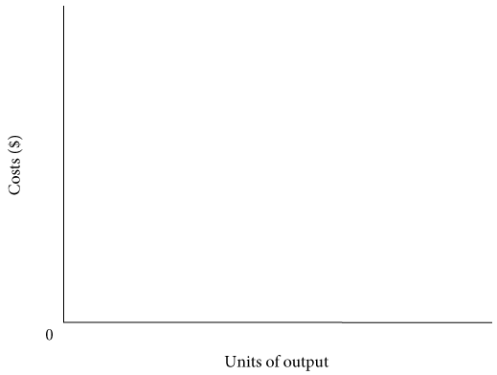

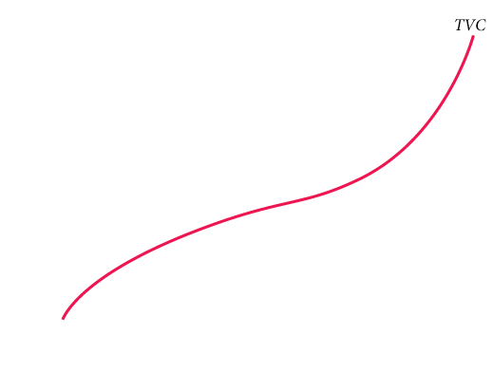
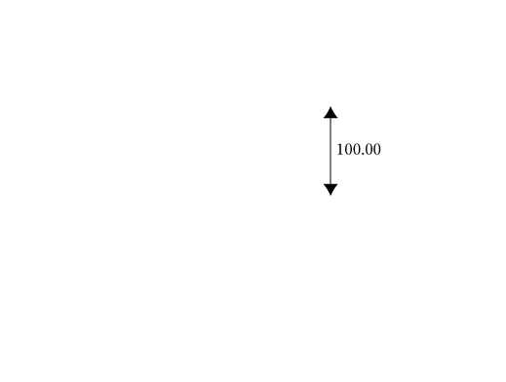
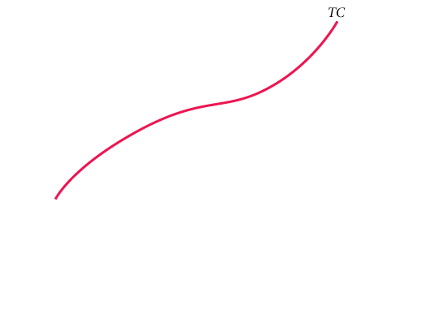
Total Costs
① FIGURE 8.7 Total Cost = Total Fixed Cost + Total Variable Cost
Adding TFC to TVC means adding the same amount of total fixed cost to every level of total variable cost.
Thus, the total cost curve has the same shape as the total variable cost curve; it is simply higher by an amount equal to TFC.

Slide 13



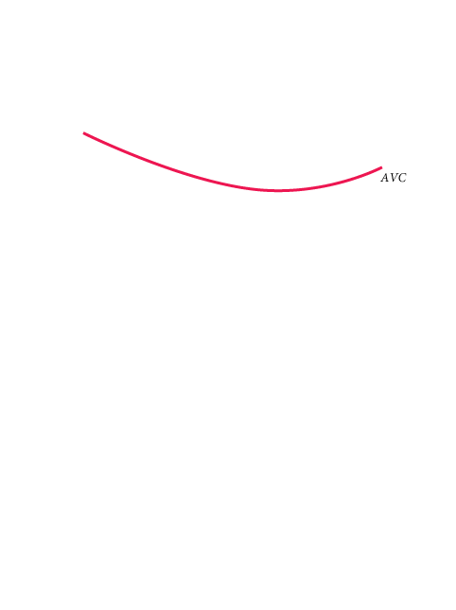
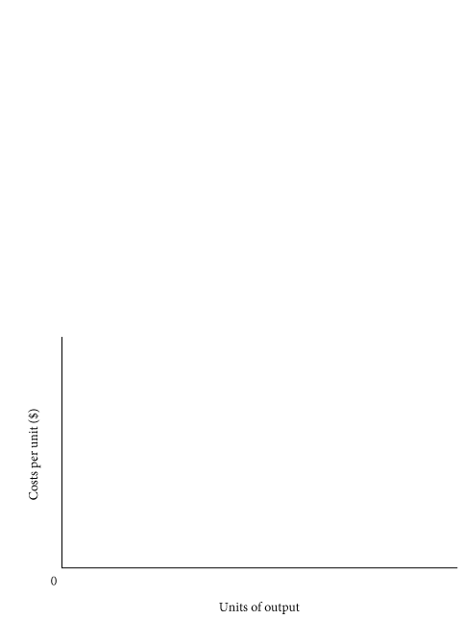

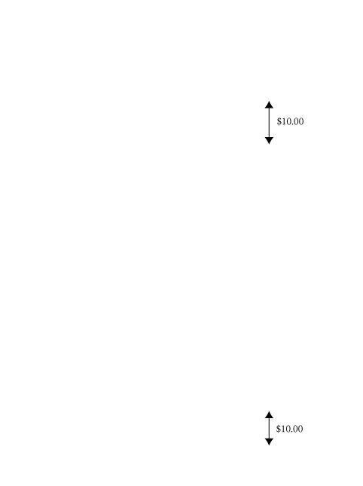
Average Total Cost (ATC)
average total cost (ATC) Total cost divided by the number of units of output.
Average Total Cost = Average Variable Cost + Average Fixed Cost
To get average total cost, we add average fixed and average variable costs at all levels of output.
Because average fixed cost falls with output, an ever-declining amount is added to AVC.
Thus, AVC and ATC get closer together as output increases, but the two lines never meet.

Slide 14
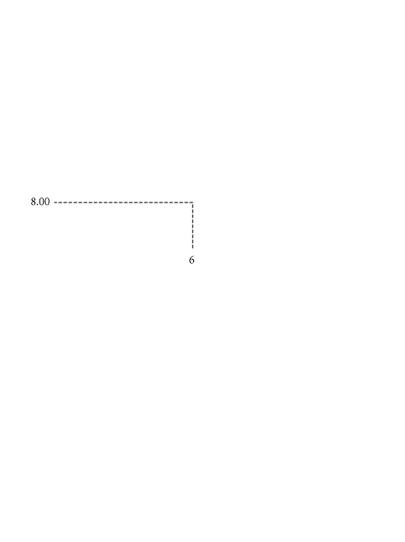
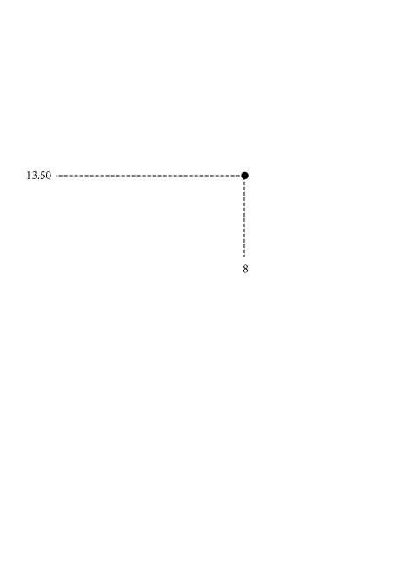

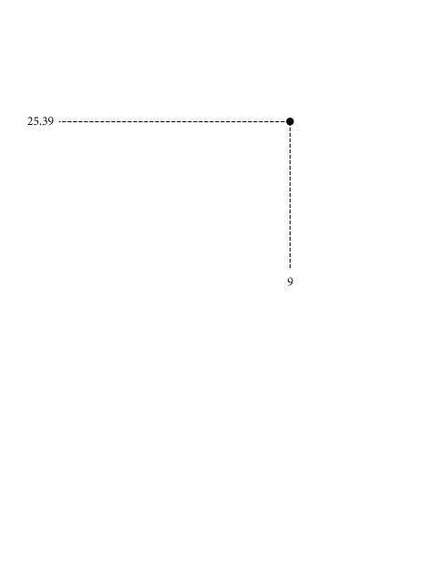

The Relationship Between Average Total Cost and Marginal Cost
The relationship between average total cost and marginal cost is exactly the same as the relationship between average variable cost and marginal cost.
If marginal cost is below average total cost, average total cost will decline toward marginal cost. If marginal cost is above average total cost, average total cost will increase. As a result, marginal cost intersects average total cost at ATC’s minimum point for the same reason that it intersects the average variable cost curve at its minimum point.

Slide 15
Short-Run Costs: A Review
TABLE 8.5 A Summary of Cost Concepts
Term | Definition |  | Equation
Accounting costs | Out-of-pocket costs or costs as an accountant would define them. Sometimes referred to as explicit costs. |  |  | −
Economic costs | Costs that include the full opportunity costs of all inputs. These include what are often called implicit costs. |  |  | −
Total fixed costs (TFC) | Costs that do not depend on the quantity of output produced. These must be paid even if output is zero. |  |  | −
Total variable costs (TVC) | Costs that vary with the level of output. |  |  | −
Total cost (TC) | The total economic cost of all the inputs used by a firm in production. | TC = TFC + TVC
Average fixed costs (AFC) | Fixed costs per unit of output. | AFC = TFC/q
Average variable costs (AVC) | Variable costs per unit of output. | AVC = TVC/q
Average total costs (ATC) | Total costs per unit of output. | ATC = TC/q ATC = AFC + AVC
Marginal costs (MC) | The increase in total cost that results from producing 1 additional unit of output. | MC = ΔTC/Δq

Slide 16
Why short run average cost curves are U-shaped?

Slide 17
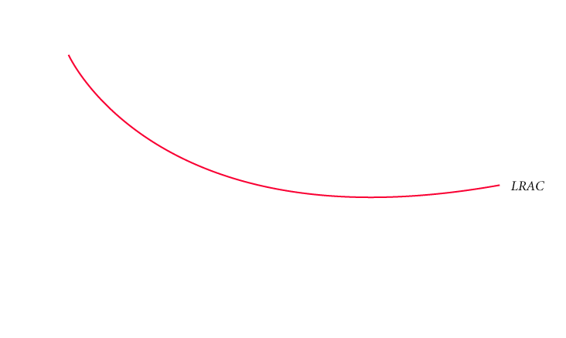
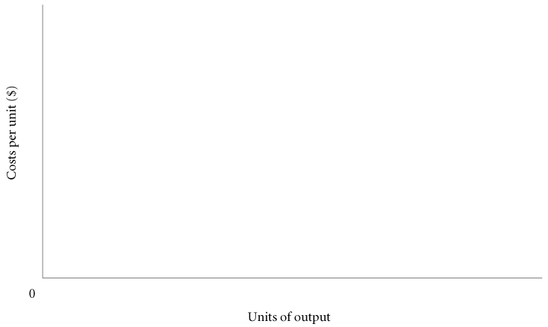
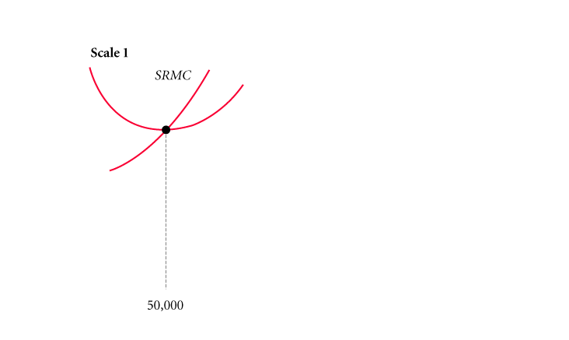
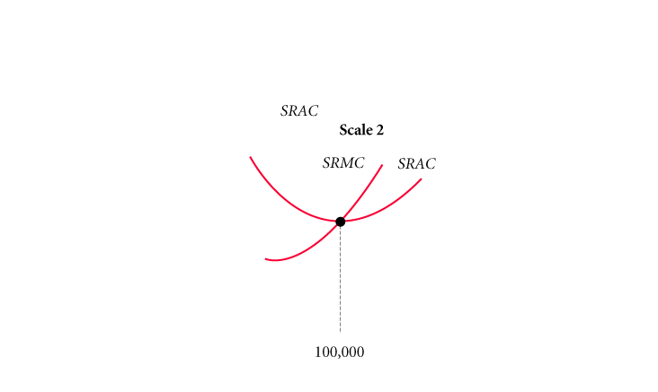
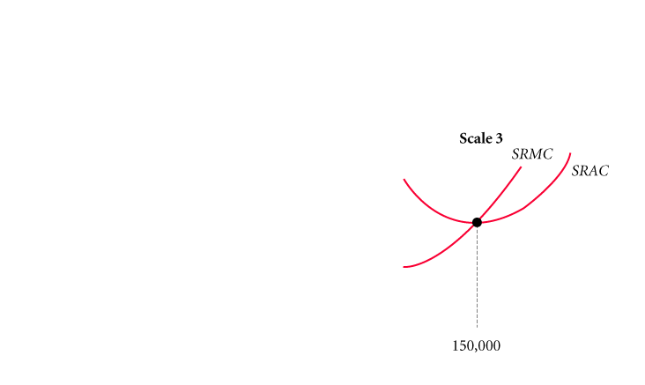
Long-run Average cost curve
long-run average cost curve (LRAC) The “envelope” of a series of short-run cost curves.
minimum efficient scale (MES) The smallest size at which the long-run average cost curve is at its minimum.

